Slide 1
McDonald’s Weekly Operations Review – Week 27
29th June 2025 – 5th July 2025

Slide 2
Agenda
1
Key Actions
2
Highlights for the past week
3
Volumetric Trends | INC, CHG, SR
4
Ticket classifications based on Business Services

Slide 3
Risk Register
Risk Description | Priority | Risk Owner | Risk Response | Identified On | Target Date | Status | Review Date
SDWAN - No ISP Redundancy for 21 SDWAN Sites | High | Angel Satcher | US - 9, APAC- 7, EU - 8 Sites have No ISP redundancy/Site running on single Router with Single ISP. | 2023 | TBD | Open | Monthly
MHQ & 711 Switches Out of Support | Moderate | Sudarshan | The Switches under MHQ & 711 switches are out of smart net support and End of Support. New switches have been procured and are at MHQ and switch replacement activity is in progress. | 2024 | Jan 2025 | Open | Monthly
CNF| R07 is single point of failure | High | Hamad Abbasi | R08 in production for Accenture / US Market and Yorktel. All the markets will start getting redundancy over R7/R8 in each CNF for US in 1st phase | 2023 | End of 2025 | Inprogress | Monthly
User testing post Change implementation | Moderate | Sudarshan/Angel | Post any change implementation during on/off business hours the users are unavailable to test the connectivity, also test the change output as all the McDonalds end users are unavailable which leads to issues being reported at a later point in time. | 2024 | N/A | Open | Monthly
Saskatoon & Regina Office Closure | Moderate | Sudarshan | Sites have been decommissioned in Nov 2024, however Regina Expereo link is still active, Sudarshan is working with Expereo to decommission the link | 2024 | Q2 2025 | Open | Weekly
Meraki Security Appliance Hardware Limitation | Moderate | Sudarshan/Angel | MX84 and MX100 are not supported above 18.1*** image. There are 12 devices that falls under “Product Firmware Version Restrictions”. Risk: , If there are any bugs identified on this current version, the only option is to perform a hardware upgrade, as per TAC. | 2024 | TBD | Open | Monthly
CNF IOS Upgrades | High | Hamad Abbasi | All CNF Routers upgraded on 17.9.5a, for all the 6 CNFs | 2024 | Q1 2025 | Closed | Monthly
License | High | Sudarshan/Tim | DNAC License Renewal | 2025 | Q2 2025 | Open | Weekly
Firewall Access | High | Joy/Soumik | Port 80 allowed in the CNF network over firewall | 2025 | Q2 2025 | Open | Weekly

Slide 4
P1/P2 - Critical incidents received for the past week
0 P1 and 1 P2 user incidents reported last week however it was not a potential P2.
P1|P2 troubleshooting calls that network team got involved in the past week (with /without ticket in Cognizant groups) - 0
Number | Created | Short Description | State | Priority | Status
INC17302639 | 01-06-2025 01:22:30 | US || Chicago || PROD|| CNF || USMCCCCHIIL01R05 Router Reboot | Closed | 2 - High | We have reloaded the router post which router was accessible via TACACS and also DRAM memory got released.

Slide 5
Network Highlights for the Week
CNF
McDonald’s Offices
We have performed Router Reboot - USMCCCCHIIL01R05.
We have installed Patch 6 to mitigate Vulnerability - CVE-2025-20281
SDWAN
NOC Hypercare
We have Removed floating static route for Czech and Slovakia
Hypercare Communication || CHG9135177 - US || PROD|| Replacement of Chicago R5 router (USMCCCCHIIL01R05) RMA- 804117556
No Major Changes implemented during this week as we are in the year end BPP.
Total Hypercare Hours for the week:168
5

Slide 6
Volumetric Trend for the past 27 weeks – INC | RITM
INC | Week 24 | Week 25 | Week 26 | Week 27
P1 | 0 | 0 | 0 | 0
P2 | 0 | 1 | 3 | 1
P3 | 855 | 375 | 640 | 196
P4 | 603 | 1063 | 456 | 460
Total | 1458 | 1458 | 1099 | 657
RITM | Week 24 | Week 25 | Week 26 | Week 27
P1 | 0 | 0 | 0 | 0
P2 | 0 | 0 | 0 | 0
P3 | 55 | 55 | 62 | 33
P4 | 9 | 9 | 21 | 7
Total | 64 | 64 | 83 | 40
Major contributors are Node Down/unreachable alerts –18, Interface down alerts –337, Interface Error/ Utilization based alerts –195, QROC based alerts –6 Others -101
Total RITMs fulfilled in the Week 27 is 40, Fulfilled - 15

Slide 7
Volumetric Trend for the past weeks – INCs Segregation by Created-Resolved by
02 out of 11 manually created tickets are by users/partners.
Manual Tickets raised by Internal Support Team
Assignment Group | Ticket Count
Cognizant Network Firewall | 4
Cognizant Network Ops | 5
Cognizant Network Ops L2/L3 | 2
Total | 11

Slide 8
Tickets Handled Trends - INC & RITM
Total Incidents raised for the week 27 is 669
Major contributors are Node Down/unreachable alerts –18, Interface down alerts –337, Interface Error/ Utilization based alerts –195, QROC based alerts –6 Others -101
Total RITM raised for the Week 27 is 52, Fulfilled – 15

Slide 9
Volumetric Trend for the past 27 weeks – Change Requests handled
Type | Week 24 | Week 25 | Week 26 | Week 27
Automated Change | 38 | 32 | 31 | 24
Expedited Exception | 1 | 3 | 7 | 2
Emergency | 4 | 2 | 1 | 1
Normal | 37 | 27 | 10 | 2
Informational | 1 | 2 | 6 | 7
Total | 81 | 66 | 55 | 36
Closure Type | Week 24 | Week 25 | Week 26 | Week 27
Successful | 81 | 65 | 55 | 45
Successful with issues | 0 | 1 | 0 | 0
Unsuccessful | 0 | 0 | 0 | 0
Total | 81 | 66 | 55 | 45
36 successful changes for Week 27

Slide 10
Business Service classification (INC, RITM & Changes) – Weekly
Business Service - INC | Week 24 | Week 25 | Week 26 | Week 27
Cloud Edge - Network (CNF) | 97 | 82 | 82 | 88
Cloud Managed Network LAN & Wifi (US & Canada) | 38 | 33 | 38 | 25
Cloud Edge Firewall | 0 | 1 | 12 | 5
Cognizant QROC log aggregation and correlation | 562 | 05 | 5 | 6
Content Delivery Network (CDN, Akamai) | 1 | 2 | 2 | 0
SD-WAN | 253 | 296 | 226 | 243
Managed WIFI/LAN | 485 | 1014 | 731 | 290
WAN - ATT | 0 | 1 | 0 | 0
WAN - Cognizant | 1 | 2 | 0 | 0
Grand Total | 1458 | 1439 | 1099 | 657
Business Service - RITM | Week 24 | Week 25 | Week 26 | Week 27
Cloud Edge - Network (CNF) | 7 | 5 | 3 | 6
Cloud Edge Firewall | 36 | 30 | 35 | 21
Cloud Managed Network LAN & Wifi (US & Canada) | 0 | 6 | 3 | 0
Cloud Managed Network LAN & Wifi (EU & APMEA ) | 0 | 1 | 0 | 0
Cognizant QROC log aggregation and correlation | 0 | 2 | 2 | 0
Content Delivery Network (CDN, Akamai) | 10 | 7 | 6 | 2
IP Allocation Management (IPAM) | 2 | 1 | 4 | 1
Managed WIFI/LAN | 8 | 14 | 8 | 5
SD-WAN | 3 | 4 | 2 | 5
VPN | 0 | 0 | 0 | 0
WAN - Cognizant | 2 | 0 | 0 | 0
Grand Total | 79 | 70 | 63 | 40
Major contributors are Node Down/unreachable alerts –18, Interface down alerts –337, Interface Error/ Utilization based alerts –195, QROC based alerts –6 Others -101
Business Service - Change Requests | Week 24 | Week 25 | Week 26 | Week 27
Cloud Edge - Network (CNF) | 14 | 11 | 11 | 6
Cloud Edge Firewall | 48 | 34 | 28 | 23
Cloud Managed Network LAN & Wifi (EU & APMEA) | 0 | 0 | 0 | 0
Cloud Managed Network LAN & Wifi (US & Canada) | 1 | 3 | 1 | 0
Cognizant QROC log aggregation and correlation | 0 | 0 | 0 | 0
Content Delivery Network (CDN, Akamai) | 2 | 8 | 7 | 2
IP Allocation Management (IPAM) | 0 | 0 | 0 | 0
Managed WIFI/LAN | 9 | 7 | 7 | 1
SDWAN | 2 | 3 | 1 | 4
Grand Total | 93 | 66 | 54 | 40

Slide 11
Top 4 Issue Types for Week 27
Issue Type | INC Count | Issue Description | Observation | Actions Taken-Recommendation-Comments
Interface Down alerts | 337 | Link connecting to Interface is Down | MHQ – 271 CMN –13 SDWAN – 33 CNF – 20 | 271 MHQ alerts triggered due to Av interfaces flap, Audio and Video device and some alerts due to ISE node patching on AWS and MHQ Nodes 13 CMN Alerts triggered due to network interface status flap connected to Xerox/printer and user ports. 33 SDWAN alerts triggered due to TLOC link down and flap on Delhi devices and for Portugal devices due to WAN link down and interface flap. 20 CNF alerts triggered due network interface down as interface Tunnel’s were flapping for Chicago R05 and Ashburn R05
Interface Utilization / Error Rate alerts | 195 | Interface Errors / Utilization ​transmit-Receive | SDWAN – 175 MHQ – 7 CNF –12 | 175 SDWAN alerts triggered due to high utilization on the interface bandwidth. 15 MHQ alerts triggered due to clear interface discard error rate. 12 CNF alerts triggered due to clear interface discard error.
Node unreachable alerts | 18 | Devices were unreachable due to ISP-Power issues.​ | CMN – 11 SDWAN – 4 MHQ -- 3 | 11 CMN Alerts triggered due to Network outage for aviation center 13 SDWAN alerts triggered due to BFD session flap in Mauritius and Portugal 3 MHQ Alerts triggered due to Network outage for aviation center
QROC offense related incidents | 06 | QROC alerts when a suspicious activity is observed | The alerts observed are normal and expected and are received based on risk score and port numbers and resolved after confirmation with respective teams. | These incidents are triggered based on multiple use-cases. These are normal or expected tickets as per the rules and use-case logic.

Slide 12
Aging Tickets Status > 10 days
Aging Incident : 3
Aging RITM : 15
Number | State | Assigned to | Priority | Short Description | Assignment group
INC17335285 | Pending User | Parth Sharma | 3 - Moderate | Wi-Fi - Unable to connect to private network | Cognizant Network Ops L2/L3
INC17343729 | Pending Problem | Padmanabhan Ramamoorthy | 4 - Low | VPN Flap between Sirius/CDW and McD | Cognizant Network Ops
INC17318106 | Pending User | Sarfaraz Ahmad | 4 - Low | slowness problem between GRA and SDWAN | Cognizant Network Ops L2/L3
Number | State | Assigned to | Priority | Short Description
RITM11894392 | Pending Change | Govardhan Reddy Y | 4 - Low | add DANTE DNEMO test device to DACL -MAC 00:1D:C1:80:18:CA
RITM11913344 | Pending Change | Balamurugan C | 3 - Moderate | Add the AWS ISE server to the IPsec encryption list to enable access for TrueOffice
RITM11903524 | Pending Change | Abed Shaikh | 3 - Moderate | Allow jump server ip on R5 rouer in CNF
RITM11913174 | Pending Change | Tarun Shee | 3 - Moderate | Change | Advertise new Acrom LABs subnet 100.99.160.0/20 (RITM11878523) on Acrom's GSC connection
RITM11913920 | Pending Change | Sridip Pramanik | 3 - Moderate | Chicago MHQ || Prod || Office || Interface description configuration on MHQ Switches based on CDP and LLDP
RITM11889721 | Pending Change | Arunava Roy | 3 - Moderate | Connecting the management port of new router to management switch(USMCCCCHIIL01S05 ) for access the new router and configuration
RITM11904928 | Pending Change | Tarun Shee | 3 - Moderate | Debug USMCCCCHIIL01R05 Memory traceback due to memory leak issue
RITM11904817 | Pending Change | Sridip Pramanik | 3 - Moderate | Need to remove the CosMc's sites from Monitoring
RITM11889896 | Pending Change | Arunava Roy | 3 - Moderate | Replacement of Chicago R5 router (USMCCCCHIIL01R05) Scheduled for June 20 from 00:00 to 03:00 CST, in coordination with Equinix support
RITM11892165 | Pending Change | Nanagouda S | 3 - Moderate | Request to monitor during planned OCI router maintenance - July
RITM11885466 | Pending Change | Yogesh Awadhut | 3 - Moderate | US CNF || Chicago, Ashburn || Prod || Migration of ARCOS secondary connection from R07 to R08
RITM11897167 | Pending Change | Yogesh Awadhut | 3 - Moderate | US CNF || Chicago, Ashburn || Prod || Migration of CANADA secondary connection from R07 to R08
RITM11906604 | Pending Change | Christopher Arrington | 3 - Moderate | USRIC001 + USSA001 || Production || Data Center || Migrate MPLS Circuits to 1g Internet Circuits ||
RITM11913964 | Pending Tasks | Arunava Roy | 4 - Low | Yorktel/Amsterdam. Request for additional VPN Tunnel
RITM11913965 | Pending Tasks | Arunava Roy | 4 - Low | Yorktel/Frankfurt. Request for additional VPN Tunnel -

Slide 13
CNF Link Utilization for Week 27
Incident # | Average Utilization | 95th Percentile | Remarks
Chicago CNF | 13% | 22% | No Anomalies reported
Ashburn CNF | 7% | 9% | No Anomalies reported
Frankfurt CNF | 9% | 12% | No Anomalies reported
Amsterdam CNF | 9% | 17% | No Anomalies reported
Hong Kong CNF | 1% | 1% | No Anomalies reported
Singapore CNF | 13% | 40% | No Anomalies reported

Slide 14
Breach analysis (INC, RITM & Change Requests) for Week – 27
Incidents :
RITM :
Incident SLA :
No defaulters for the week.
Completion SLA :
No defaulters for the week.
Change Requests :
Actions taken:
Process SLA :
No defaulters for the week.
Process SLA :
No defaulters for the week

Slide 15
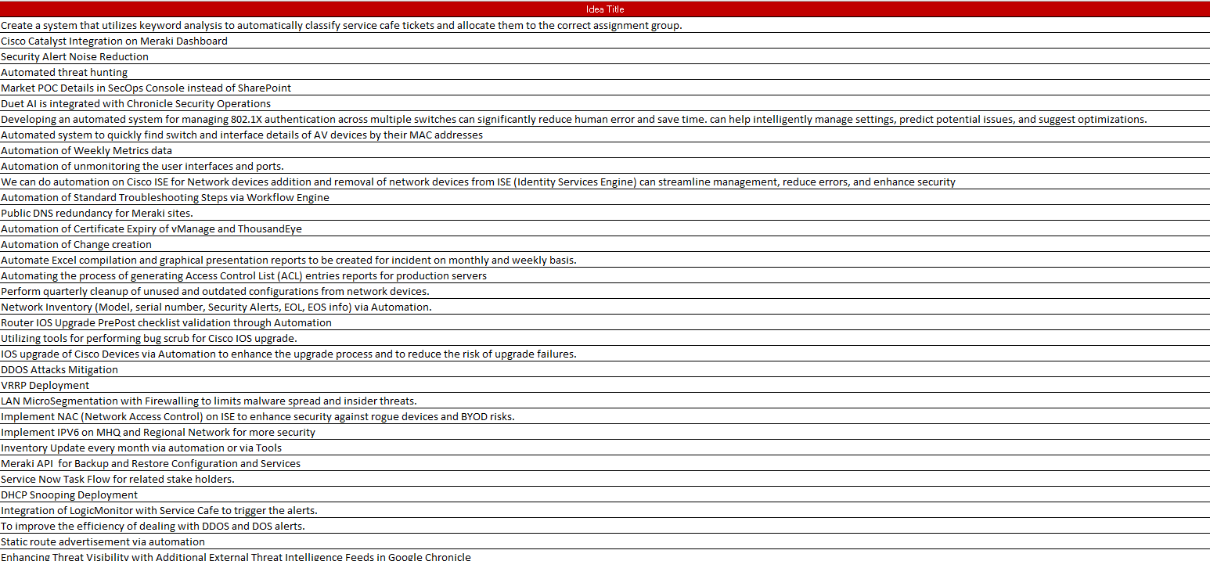
Cognizant Bluebolt Initiative

Slide 16
Thank You!

Slide 17

Appendix

Slide 18
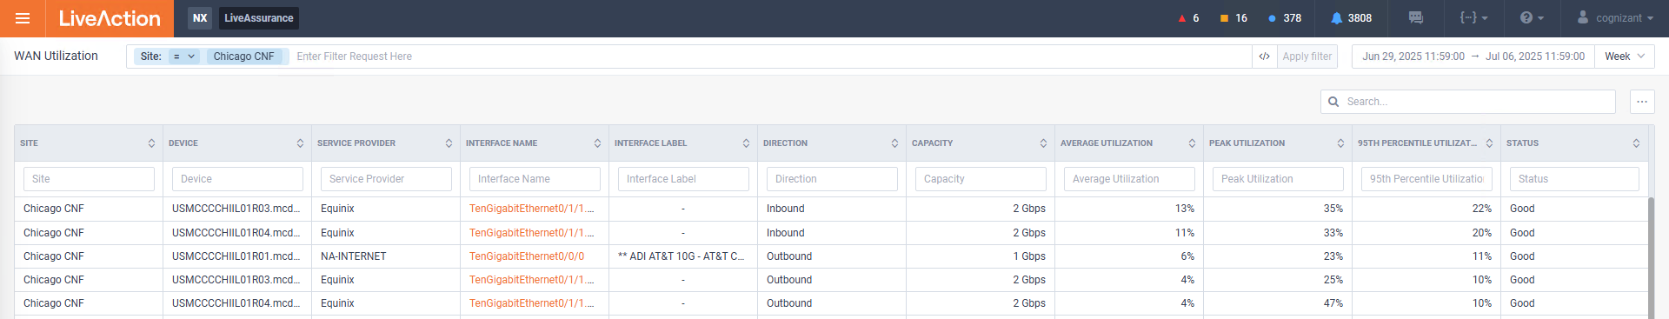
Network Performance
Chicago Network Utilization for the Week 27
No anomaly for the week 27

Slide 19
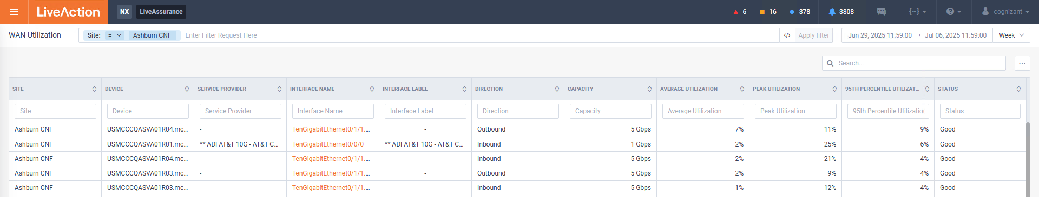
Ashburn Network Utilization for the week 27
Network Performance
No anomaly for the week 27

Slide 20
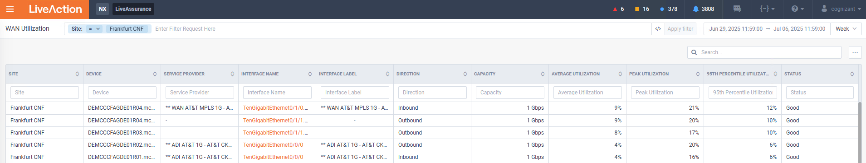
Network Performance
Frankfurt Network Utilization for the week 27
No anomaly for the week 27

Slide 21
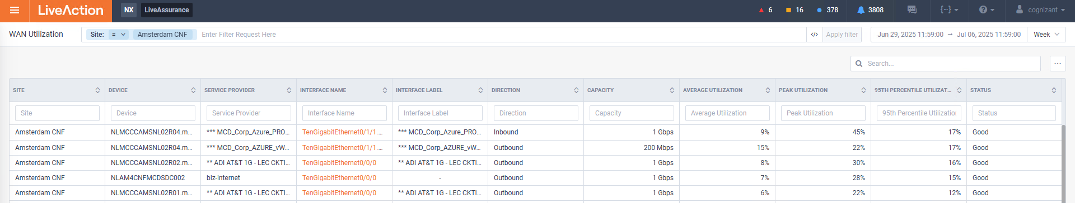
Network Performance
Amsterdam Network Utilization for the week 27
No anomaly for the week 27

Slide 22
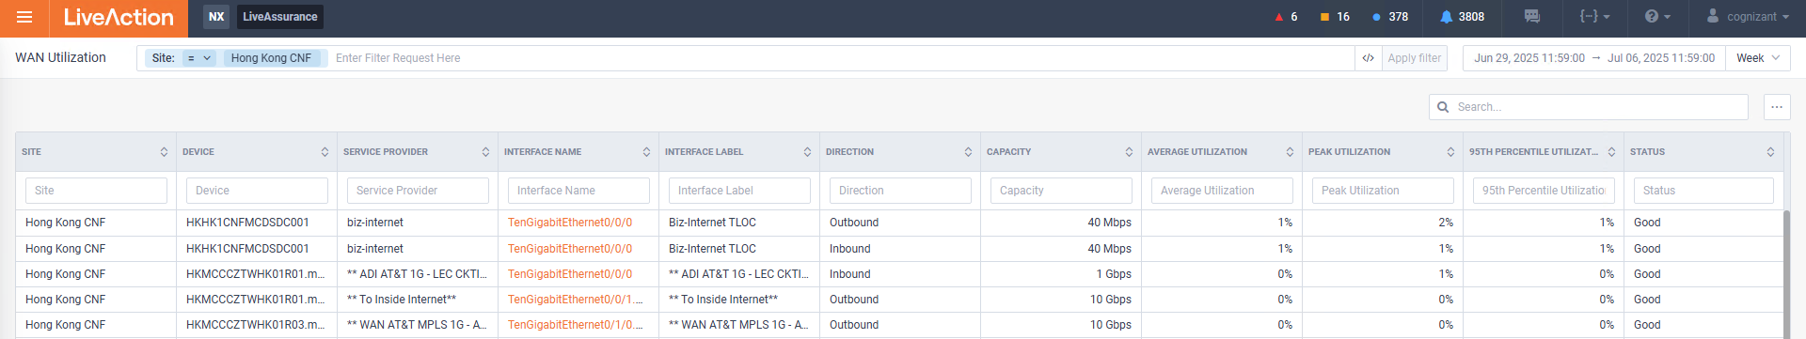
Network Performance
Hong Kong Network Utilization for the week 27
No anomaly for the week 27

Slide 23
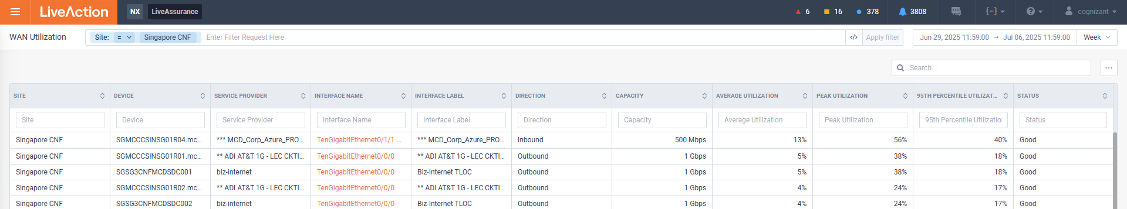
Network Performance
Singapore Network Utilization for the week 27
No anomaly for the week 27

